Slide 1

Fact and Friction: Mandating Friction to Fight False News
Computer Science and the Law Roundtable
Center for Technology, Innovation & Competition
University of Pennsylvania
5/24/2023
Paul Ohm, Ayelet Gordon-Tapiero, Ashwin Ramaswami

Slide 2




Slide 3


Slide 4



Slide 5

Friction-in-Design to Combat False News

Slide 6


False News
Individual Harms
Societal Harms
=> Undermining trust in democracy and its institutions

Slide 7


Friction to Fight False News

Slide 8
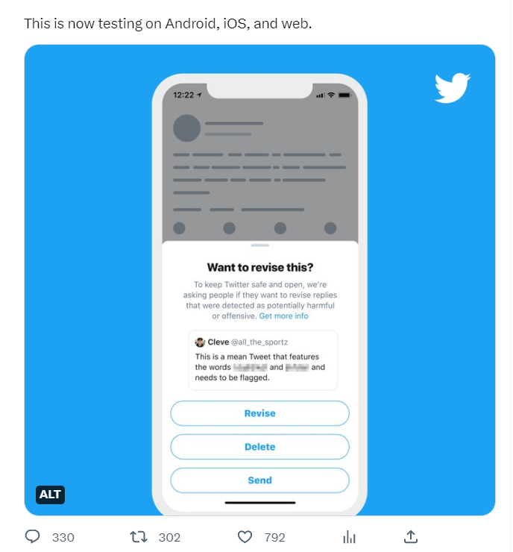
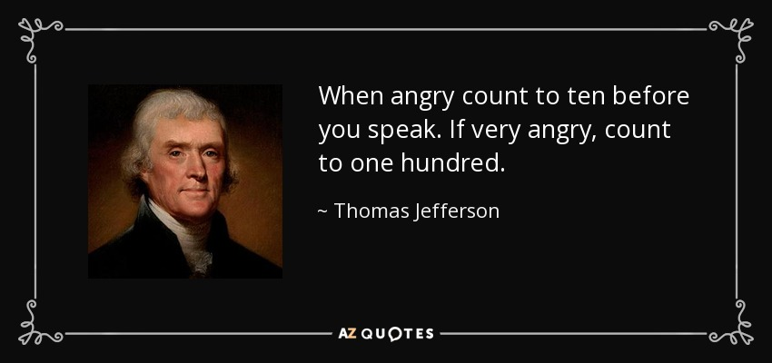

Slide 9
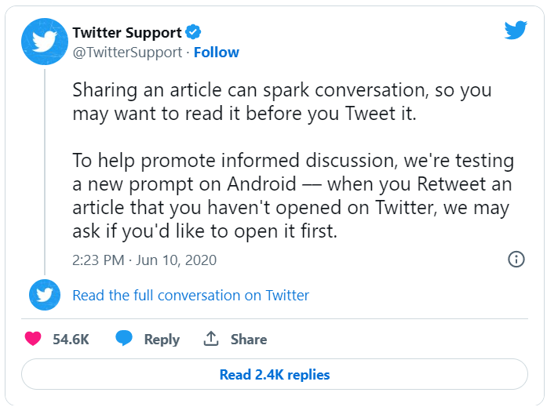

Slide 10

2017-2018 - India - Conspiracy Theories
Forwarding limit - 5 chats at a time
2018 - Brazil - Election false news
1/2019 - Forwarding limit applied worldwide
8/2019 - Introduction of the double arrow icon
2020 - COVID-19 false news
FF messages forwarding limit - 1 chat at a time
4/2020 - 70% lower spread of viral content

Slide 11
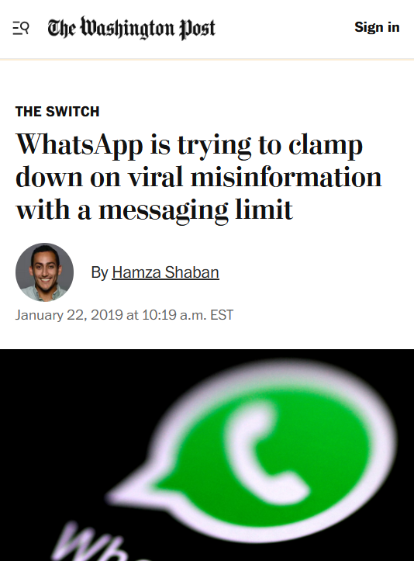
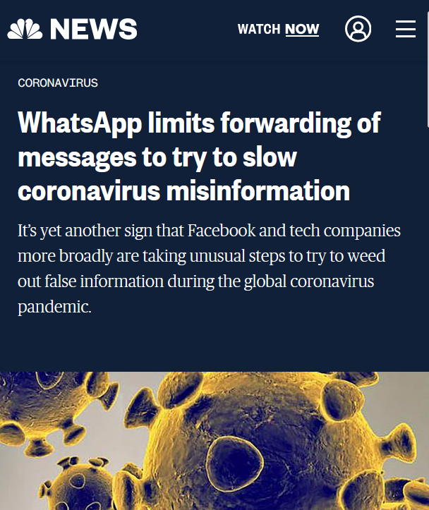
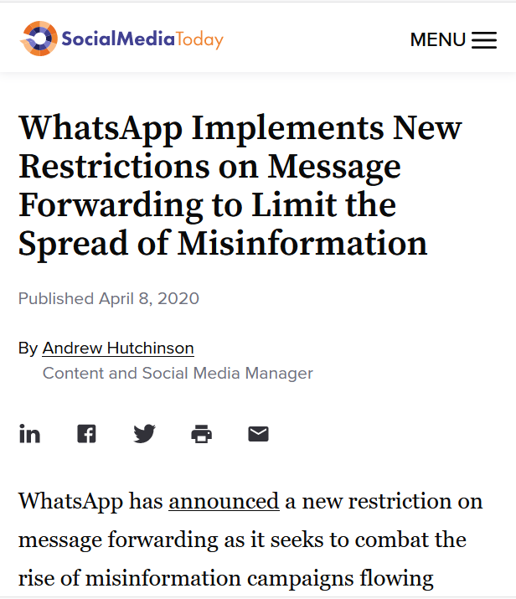

Slide 12
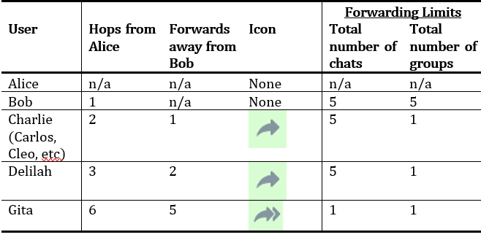
Our Findings: Behavioral

Slide 13
Behavioral Insights
Copy-paste workaround
Forwards are counted by depth not breadth
C1
A
B
C2
D
C3

Slide 14
Our Findings: Static Analysis

Slide 15
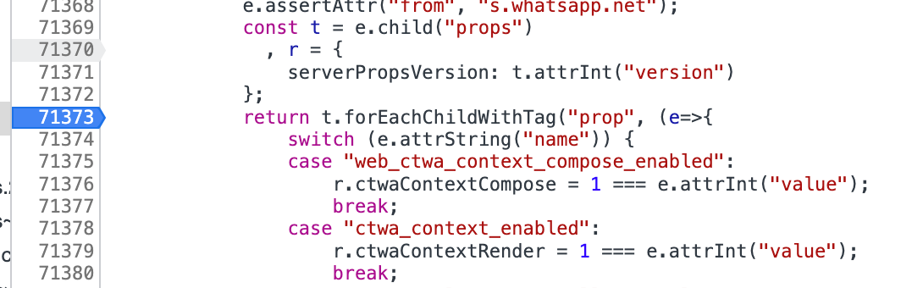

Our Findings: Dynamic Analysis
r.frequentlyForwardedMax = 10;

Slide 16
Our Findings: Dynamic Analysis

Slide 17
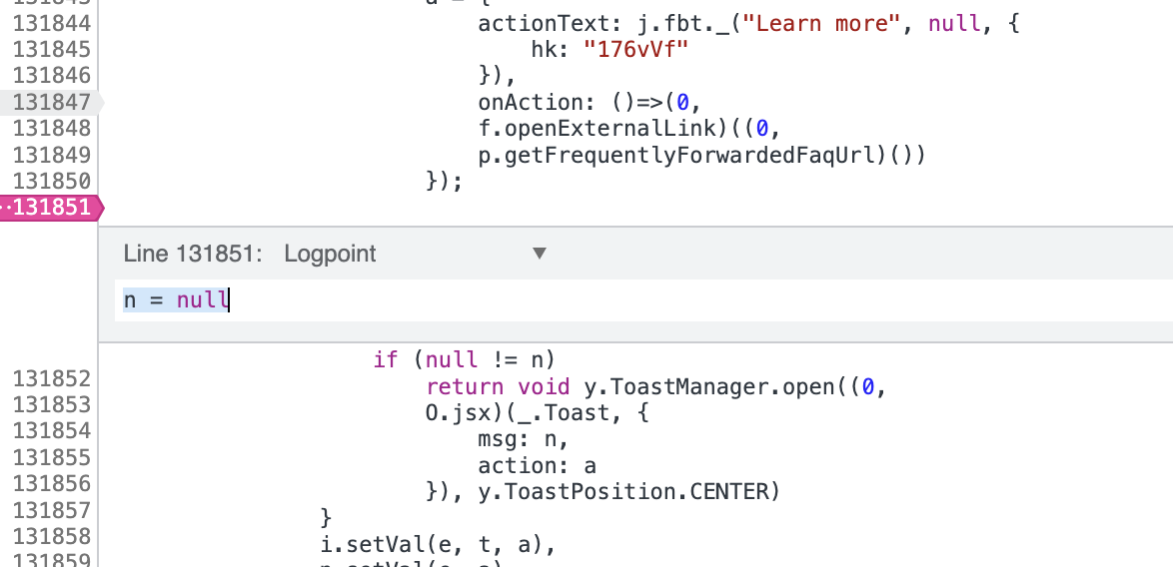
Our Findings: Dynamic Analysis
Notes:
Our final technique was perhaps the most complete and systematic. In the code that limited the number of recipients who could receive a forwarded message, we found a variable n, that appeared to be the critical value that is checked to detect when a user has tried to add more than the maximum number of chats or groups. We determined that we could wipe n at a particular, critical juncture in the code, depicted here:
With this simple change, we could ignore all of WhatsApp’s forwarding limits. We could send any WhatsApp message—whether non-forwarded, forwarded, or frequently forwarded—to an unlimited number of chats and groups at one time. This change would persist for as long as the browser tab was kept open.

Slide 18
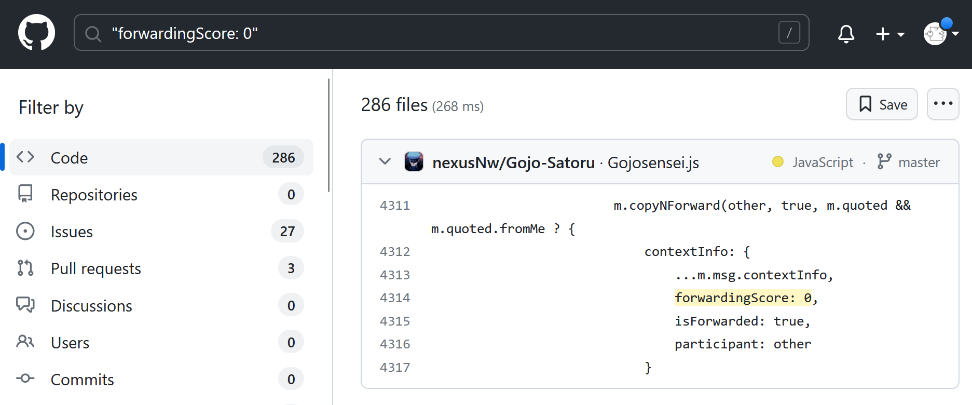
Our Findings: Circumvention in the Wild?
Notes:
Our final technique was perhaps the most complete and systematic. In the code that limited the number of recipients who could receive a forwarded message, we found a variable n, that appeared to be the critical value that is checked to detect when a user has tried to add more than the maximum number of chats or groups. We determined that we could wipe n at a particular, critical juncture in the code, depicted here:
With this simple change, we could ignore all of WhatsApp’s forwarding limits. We could send any WhatsApp message—whether non-forwarded, forwarded, or frequently forwarded—to an unlimited number of chats and groups at one time. This change would persist for as long as the browser tab was kept open.

Slide 19
A “Responsible Disclosure” interlude…
May 2, 2023: From Us: “Following principles of coordinated disclosure and the specific guidelines, we are disclosing our results to you so that WhatsApp may have an opportunity to investigate and address the issues we have discovered.”
May 5, 2023: From Meta: “Regarding WhatsApp forwarding limits, please note that any restrictions we may have on forwarding has to be implemented on the client side (as WhatsApp is using end to end encryption), meaning that any mitigation we have can be bypassed. The only thing we can do is to limit on the server side the number of messages that can be sent at a time.”

Slide 20
A “Responsible Disclosure” interlude…
May 23, 2023: From Meta: “Thank you again for submitting this research through our bug bounty program. We’ve reviewed your paper and we wanted to share a bit more detail about the purpose of the forwarding limit, how it works and how we combat the integrity challenges you refer to in your paper.”

Slide 21
What WhatsApp tells us about friction-in-design solutions

Slide 22



Code is Law; The Design Turn

Slide 23

Content-Neutrality

Slide 24

Does it Really Work?

Slide 25

Tunability

Slide 26

Arms Race

Slide 27

Thank you!
ohm@georgetown.edu
ag2249@georgetown.edu

